Slide 1
Intro to Github workshop

Slide 2

What is Git?
Git (/ɡɪt/) is a distributed version control software system that is capable of managing versions of source code or data. It is often used to control source code by programmers who are developing software collaboratively.
Created in 2005 by the guy who created Linux
GitHub (/ˈɡɪthʌb/ ) is a proprietary developer platform that allows developers to create, store, manage, and share their code.
Owned by Microsoft since 2018

Slide 3

Why do we care tho?
Collaboration
Community
Visibility
Transparency
Reproducibility
Recoverability

Slide 4
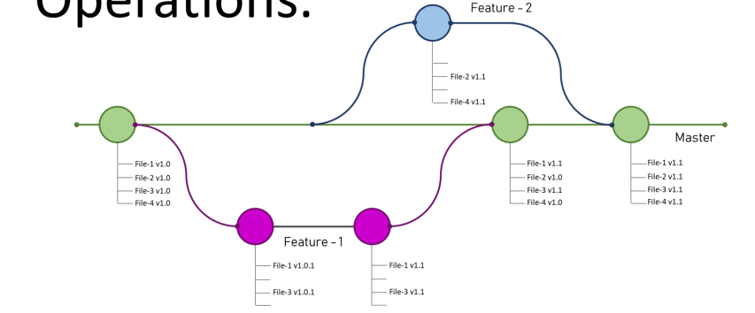
Anatomy of a repo
Graph of a repository (repo) – replicated on local (my machine) and remote (GH servers)
Main
Commit
Branch
Notes:
Repository (repo) = container for holding things, in this case, text files
Remote = your repo on Github’s servers
Local = your repo on your machine
Tree = file directory
Blob = content of a file
Branch = a copy of your tree with some changes
Commit = a saved change to your tree
Main = a protected branch that only allows commits through pull requests

Slide 5
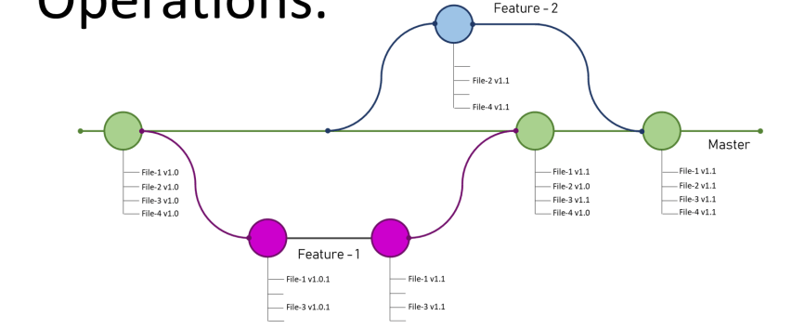
Using a repo
git add .
git commit –m “feat: new data analysis tool added”
git push
git fetch
git switch main
git pull main
git switch Feature-2
git pull main
git branch –c Feature-2
git merge main
Open Pull Request (PR), review and merge. Delete branch Feature-2
git init
OR
git clone <repo url>
Open Pull Request (PR), review and merge. Delete branch Feature-1
git pull main
git branch –c Feature-1
git add .
git commit –m “feat: new experiment conditions created”
git push
Notes:
Repository (repo) = container for holding things, in this case, text files
Remote = your repo on Github’s servers
Local = your repo on your machine
Tree = file directory
Blob = content of a file
Branch = a copy of your tree with some changes
Commit = a saved change to your tree

Slide 6
Requirements to follow this workshop
Download Github: https://desktop.github.com/download/
Create a Github account
Download VSCode: https://code.visualstudio.com/download
Log into your Github account on VSCode → left hand side on the bottom of the screen of VSCode, person looking icon.
Gain access to https://github.com/Stellenbosch-University-Process-Eng
Clone the repo https://github.com/Stellenbosch-University-Process-Eng/hello-ml-research-group.git

Slide 7
What we will do in the workshop
Clone a repo and open it in VSCode
Make a branch off main
Make some change on the repo and commit it to this branch
Open a PR and get a colleague to review it
Merge the PR
Look at some more resources on the fun stuff involved in GitHub

Slide 8
Intro to Github workshop
Thanks,
Francesca Middleton

